Slide 1


2022 Summer Internship
Commercial Vehicle & Fleet | User Research
Jingying(Charlotte) Yao

Slide 2

Agenda
Background
Project 1: NOC Workflow Study
Project 2: DAB Radio Desk Research
Project 3: R1T Framework Study
Project 4: R1T HWA Study
Conclusions
Q&A
PROPRIETARY AND CONFIDENTIAL | DO NOT DISTRIBUTE | 2

Slide 3
Background
Project 1: NOC Workflow Study
Project 2: DAB Radio Desk Research
Project 3: R1T Framework Study
Project 4: R1T HWA Study
Conclusions
Q&A
Background
About me
My Role Here
PROPRIETARY AND CONFIDENTIAL | DO NOT DISTRIBUTE | 3

Slide 4
Background
About Me
Education
MS-HCI @ Georgia Tech
BE-Digital Media Technology @ Xiamen University
Exchange-Computer Science @ Leiden University
Work
UX Research Intern @ Rivian
UX Contractor @ KWRS
…
PROPRIETARY AND CONFIDENTIAL | DO NOT DISTRIBUTE | 4

Slide 5
Background
My Role Here
My Title
UX Research Intern @ Commercial Vehicle & Fleet
My Responsibility
Conduct UX research that could facilitate product design or improvement
Conduct Secondary Research to form a foundation/context for product new features
Conduct User Research to gather data from actual users
Conduct Usability Testing to gain feedbacks on existing product/features
Conduct Data Analysis to turn quantitative/qualitative data into insights
Communicate with the stakeholders to inform them with insights and prompt them to take actions
Assist senior researchers and learn from them
PROPRIETARY AND CONFIDENTIAL | DO NOT DISTRIBUTE | 5

Slide 6
Background
My projects
Project 1: NOC Workflow Study
Project 2: DAB Radio Desk Research
Project 3: R1T Framework Study
Project 4: R1T HWA Study
RivianOS – Internal Management System
EDV Infotainment System - Commercial Vehicle
R1T Framework – Consumer Vehicle
R1T Automotive – Consumer Vehicle
PROPRIETARY AND CONFIDENTIAL | DO NOT DISTRIBUTE | 6

Slide 7
Background
Project 1: NOC Workflow Study
Project 2: DAB Radio Desk Research
Project 3: R1T Framework Study
Project 4: R1T HWA Study
Conclusions
Q&A
Project 1: NOC Workflow Study
Background
Process
Key Findings
Impact
PROPRIETARY AND CONFIDENTIAL | DO NOT DISTRIBUTE | 7

Slide 8
Project 1 | Background
Project Goals
The output of this study will be used to improve the workflow of the Rivian Energy Cloud (REC) experience for the Network Operation Center(NOC) Team.
To provide the NOC team with more support on their main workspace: Rivian Energy Cloud (REC), we need to gather user insights to help the stakeholders(design/product team) empathize with the system user and make decisions on REC dashboard iteration and potential product function changes accordingly.
Background
Process
Key Findings
Impact

Slide 9
Project 1 | Background
What’s NOC
What’s REC
Network Operation Center
4 engineers
Provides 24/7 technical support for Rivian’s in-house service technicians, third-party service partners, and B2B customers for all Energy and Charging products
Rivian Energy Cloud
NOC Workspace on RivianOS
Background
Process
Key Findings
Impact

Slide 10
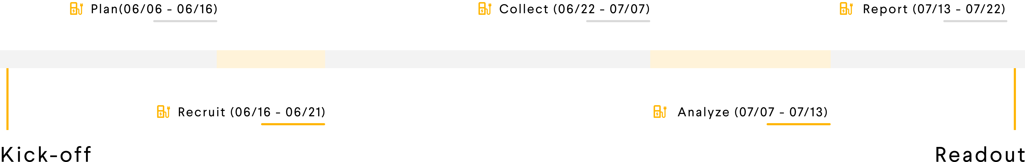
Project 1 | Process
Background
Process
Key Findings
Impact

Slide 11
Project 1 | Process
Collect
Analysis
Observation via video recording
Semi-Structured Interview
Scenario Walkthrough
Open-question questionnaire
Categorization
JTBD Analysis
Problem Tree
Background
Process
Key Findings
Impact

Slide 12
Project 1 | Process
User photos hidden because of NDA
4 participants
1h each interview session
Follow-up study in process
Background
Process
Key Findings
Impact

Slide 13
Project 1 | Key Findings
Hidden Because of NDA
Background
Process
Key Findings
Impact

Slide 14
Project 1 | Key Findings
Summary of findings
The NOC team have pain points in aspects of:
  Data Integrity – Have two sync meetings a week to ensure the data consistency in all the platforms.
  External Information Sources – Need to jump back and forth between different workplaces
  Extra Steps – Work hard to sort the information because of the cumbersome information hierarchy
  Manual Process – Having a lot of workarounds like manual commissioning checklist, etc
  Inefficiency in Collaboration – Extra communication efforts caused by limited access to systems
The dashboard doesn’t provide enough support for the NOC engineer due to lack of correlation of data and sync between other platforms
Background
Process
Key Findings
Impact

Slide 15
Project 1 | Key Findings
Summary of to-do next
Proposed Improvements:
Provide more integrated data sources and communication channels for the NOC team
Create a system to reduce manual effort:
  Incorporate the functions that could better help NOC monitor the charger behaviors, sync new site commissioning status with other stakeholders, etc;
  Simplify the process to reach the useful information
Iterate the dashboard design to provide correlation of data or visual aids that facilitates quick judgement of charger behaviors
Background
Process
Key Findings
Impact

Slide 16

Project 1 | Impact
Current
Helped the stakeholders reprioritize the backlog action items
Validated the user pains and needs and created new action items
Background
Process
Key Findings
Impact

Slide 17
Project 1 | Impact
Expected
Efficiency → Productivity
  Facilitate the NOC team with a more efficient workflow and fill in the gap between the current solution and the actual user needs.
  Help the NOC team to perform the requested service with more efficiency and more satisfying quality by simplifying/optimizing the flow.
Minimize the extra costs in the future
  Meet the user needs within one platform and reduce the cost of using other tools/devices.
  Reduce the cost of extra human resources or extra working hours by addressing the user pain points that hamper the task completion process.
  Minimize the costs caused by infrastructure down-time.
Refine the SLAs
  Help the team update their KPI goals and agreements with an upgraded workflow
Background
Process
Key Findings
Impact

Slide 18
Background
Project 1: NOC Workflow Study
Project 2: DAB Radio Desk Research
Project 3: R1T Framework Study
Project 4: R1T HWA Study
Conclusions
Q&A
Project 2: DAB Radio Desk Research
Background
Process
Key Findings
Impact
PROPRIETARY AND CONFIDENTIAL | DO NOT DISTRIBUTE | 18

Slide 19
Project 2 | Background
Context
Digital Audio Broadcast (DAB) Radio is a digital format radio service in Europe that is conceptually similar to satellite radio though DAB radio is broadcast over terrestrial-based radio towers
As part of the guidance to VUX Engineering, VUX Design needs to specify an interaction model of how users select standard FM radio stations or DAB Radio so that the proper code structure can be developed
Before diving deeper into actual user research, a fundamental Desk Research to understand user behavior over existing audio interfaces of other OEMs is needed
Background
Process
Deliverables

Slide 20
Project 2 | Process
Information Goals
Existing In-car DAB radio interfaces from different manufacturers
  whether the DAB Radio or FM radio selection occurs in the far left nav of the center display console (Framework area) or not
Typical user behaviors patterns/mental models while using DAB radio
  how users select standard FM radio stations or DAB Radio
Background
Process
Deliverables

Slide 21
Project 2 | Process
Information Sources
Main web sources
YouTube
Manufacturer manual
Manufacturer official website
Research Keywords
how to use DAB Radio in _______
DAB Radio Interface of _______
_________ manual
How to add a favorite radio station in ________
How to switch between different radio source in ________
Background
Process
Deliverables

Slide 22
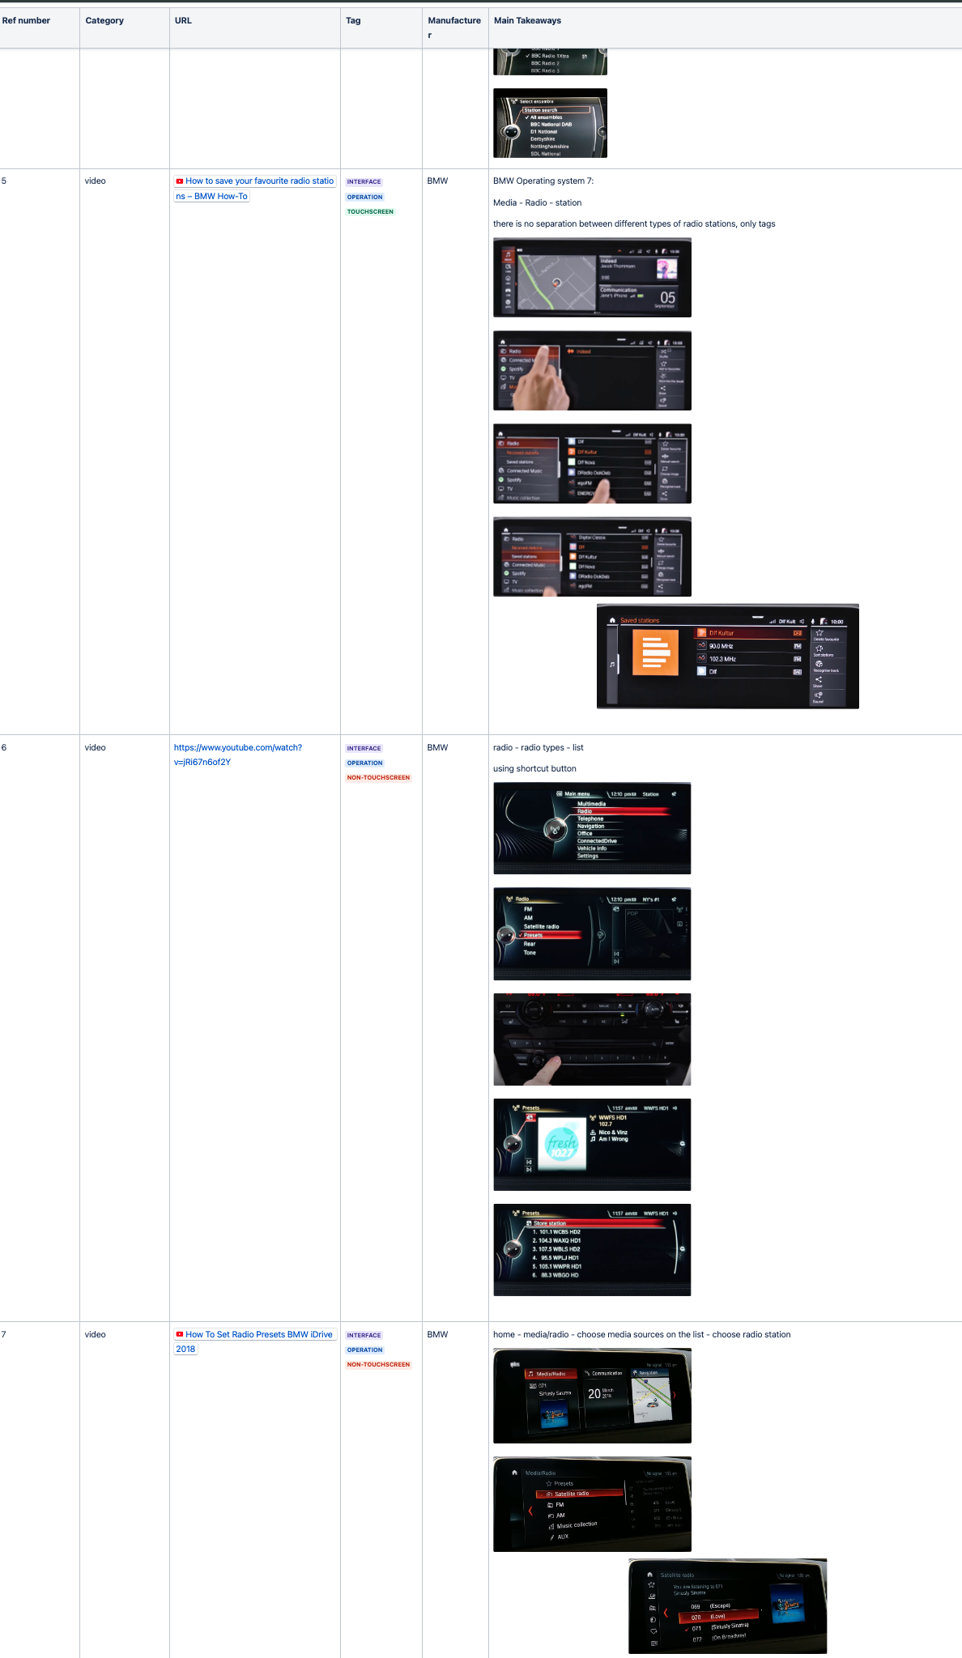
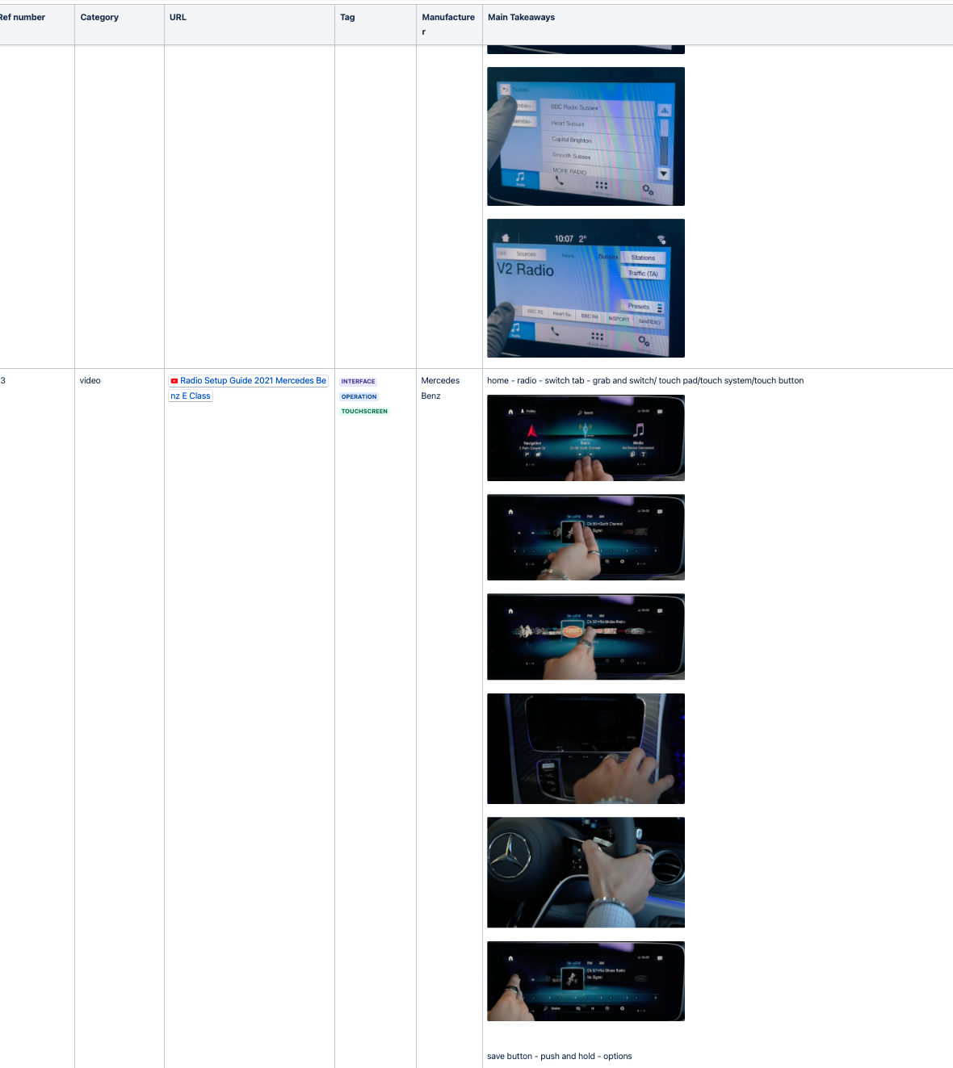
Project 2 | Deliverables
Reference list with interface screenshots and basic operation flows
Background
Process
Deliverables

Slide 23
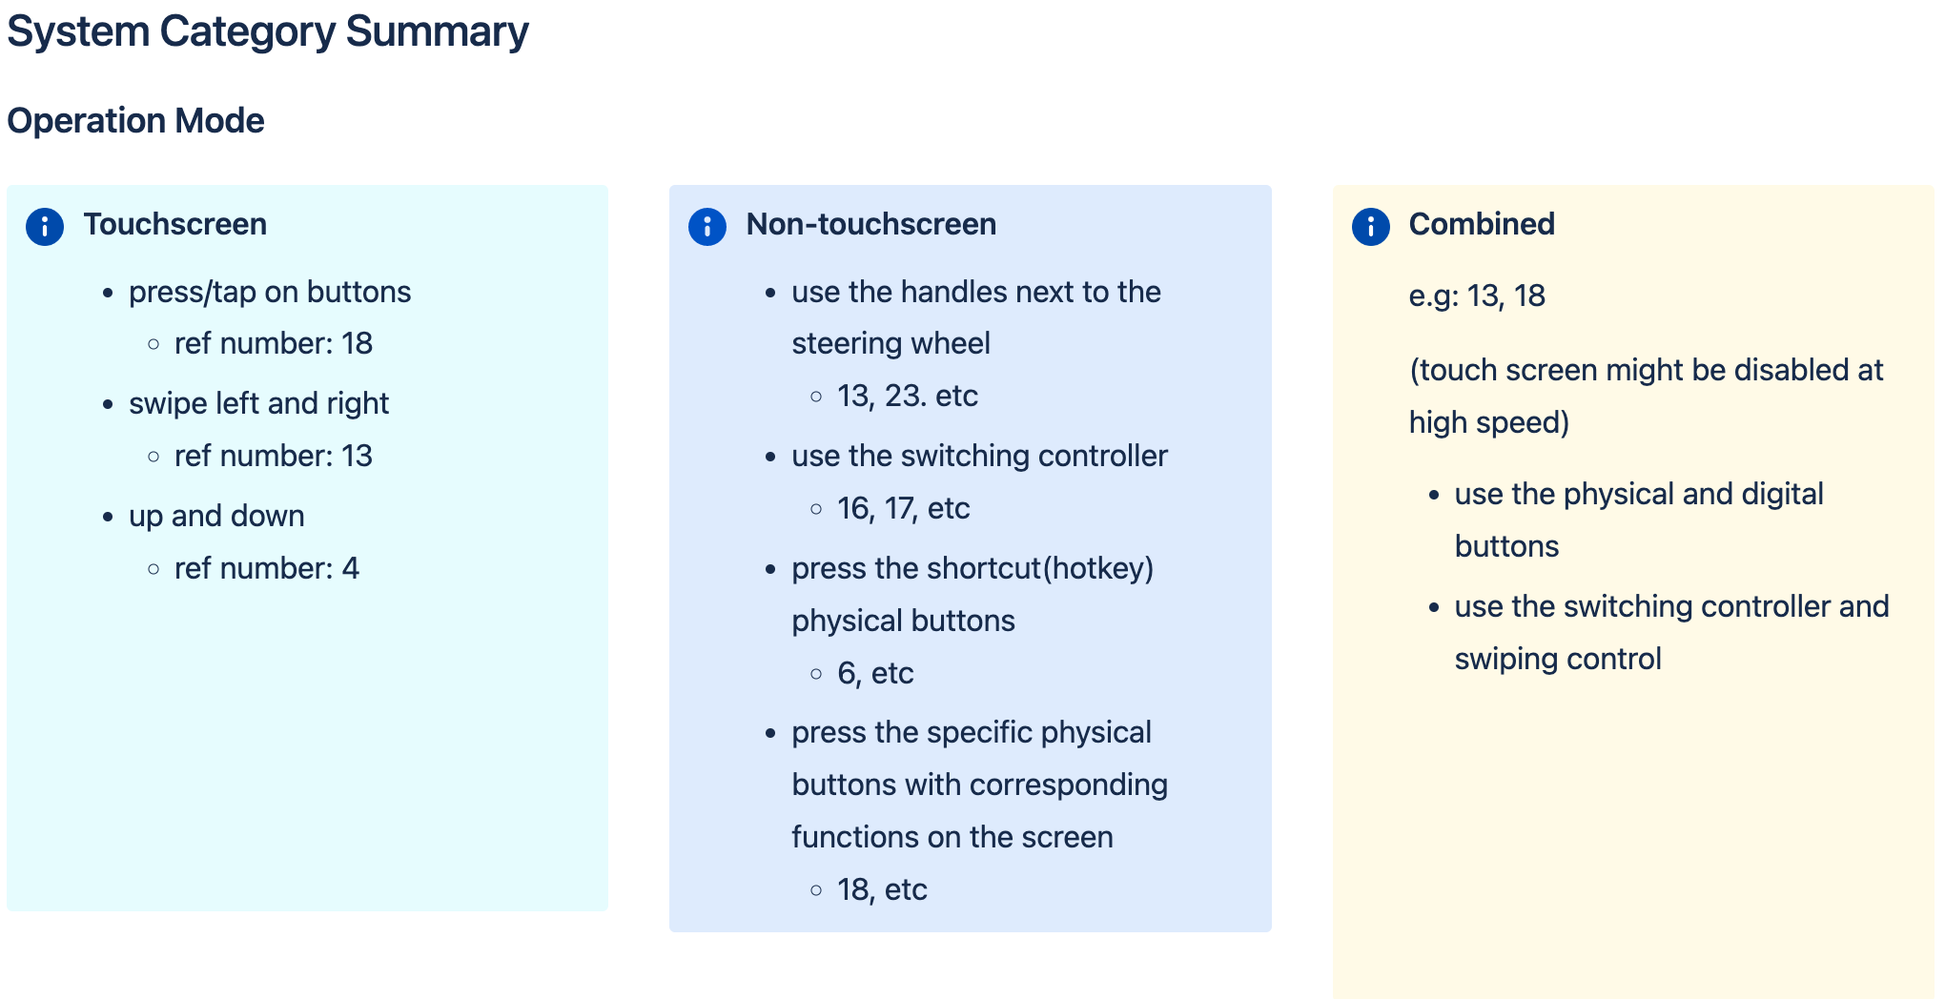
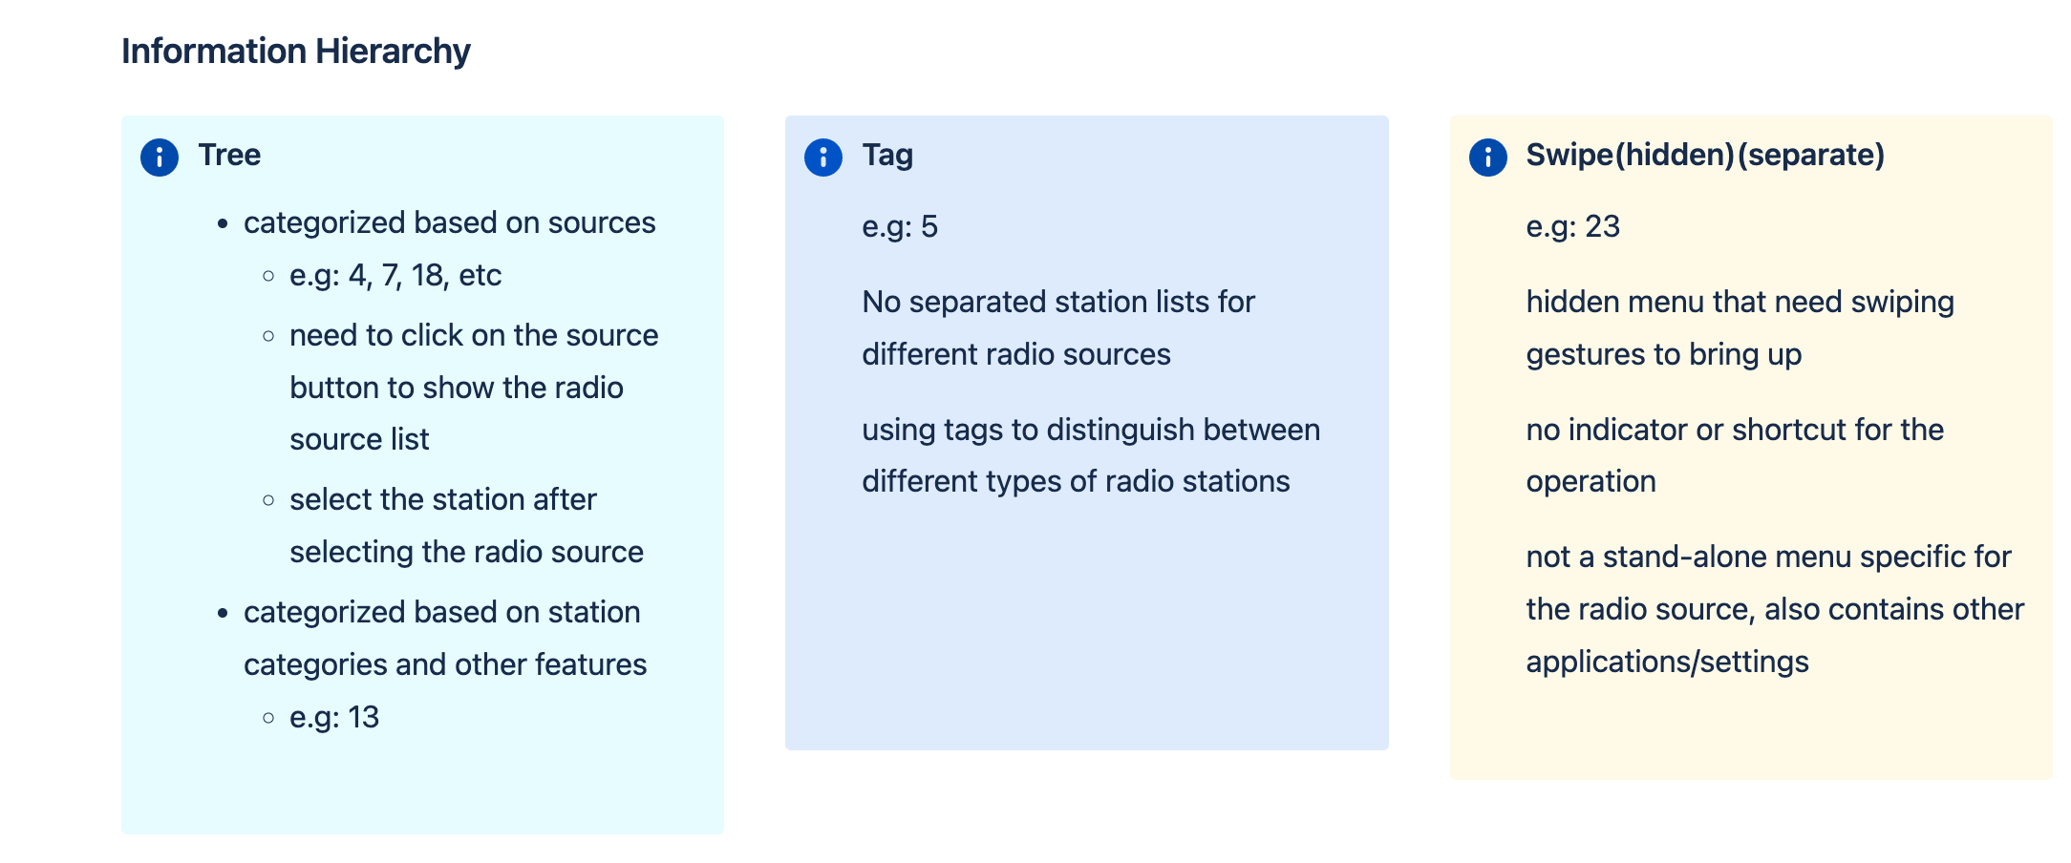
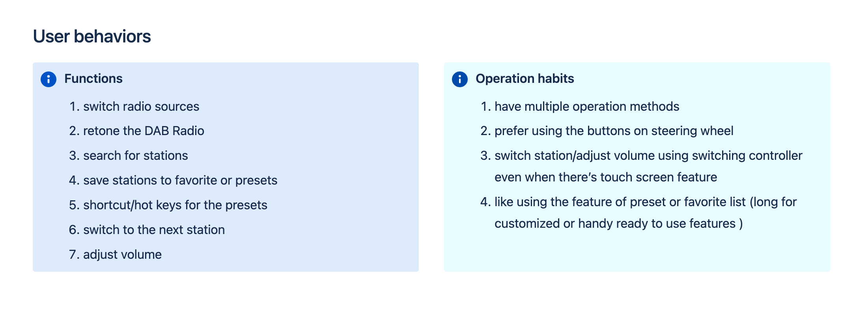
Project 2 | Deliverables
Summary of system categories
Background
Process
Deliverables

Slide 24
Background
Project 1: NOC Workflow Study
Project 2: DAB Radio Desk Research
Project 3: R1T Framework Study
Project 4: R1T HWA Study
Conclusions
Q&A
Project 3: R1T Framework Study
Background
Process
PROPRIETARY AND CONFIDENTIAL | DO NOT DISTRIBUTE | 24

Slide 25
Project 3 | Background
Context
Lead UX Researcher: Sushmita Sen
The framework design team is looking create swipe-able gestures on the
infotainment screen for customers to access controls quickly. The team also is considering redesigning the app launcher to be more adaptive to having more apps in the future.
The team is currently needing a baseline study to assess the framework of
the current R1T infotainment system. The goal would be to compare futures designs and competitors with the baseline scores
Background
Process

Slide 26
Project 3 | Background
Study Goal
The goal of this study is to evaluate the usability of essential features that would potentially be included in the new framework​
Establish product tracking metrics (NPS, SUS and Task Performance/Success)​
Build a baseline of R1T vehicle and infotainment scores​
Track product progress overtime
Background
Process

Slide 27
Project 3 |Process
Methodology
1:1 In-person static usability study in R1T
16 participants
  8 internal R1T owners ​
  8 external non-R1T owners
Flow:
Benchmark Task with a task completion scale by the moderator to measure how many representative tasks can be completed unassisted
System Usability Scale (SUS)
Net Promoter Score (NPS)
User Experience Questionnaire (UEQ)
Microsoft Product Reaction Cards
Background
Process

Slide 28
Project 3 | Process
My Role
Assisted the lead UX researcher to conduct the study:
Took qualitative notes during user session
Helped refine the study flow by observing and giving suggestions in pilot study
Asked additional questions and provided insights
Discussed and learned a lot from the lead researcher
Background
Process

Slide 29
Background
Project 1: NOC Workflow Study
Project 2: DAB Radio Desk Research
Project 3: R1T Framework Study
Project 4: R1T HWA Study
Conclusions
Q&A
Project 4: R1T HWA Study
Background
Process
PROPRIETARY AND CONFIDENTIAL | DO NOT DISTRIBUTE | 29

Slide 30
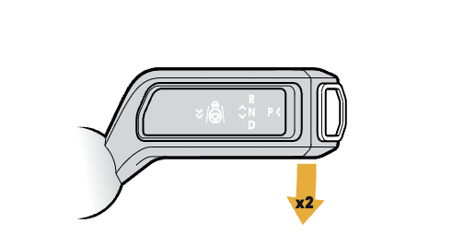
Project 4 | Background
Lead UX Researcher: Lan Wang
Goal:
Test the user behavior and mental model of Highway Assist features usage and collect technical data about the stalk use.
Background
Process

Slide 31
Project 4 | Process
Flow
50 Participants
5 – 10 min each session
Introduction
Instruction and user operation
Collect back-end data
Follow-up Qualitative Questions
Background
Process

Slide 32
Project 4 | Process
My Role
Assisted the lead UX researcher to conduct the user sessions:
Helped recruit the users
Moderated 10+ user sessions
Took qualitative notes during user sessions
Asked additional questions and provided insights
Discussed and learned a lot from the lead researcher
Background
Process

Slide 33
Background
Project 1: NOC Workflow Study
Project 2: DAB Radio Desk Research
Project 3: R1T Framework Study
Project 4: R1T HWA Study
Conclusions
Q&A
Conclusions
Takeaways
What to improve
PROPRIETARY AND CONFIDENTIAL | DO NOT DISTRIBUTE | 33

Slide 34
Conclusions | Takeaways
Learned and practiced
New research methodologies
Cross-functional collaboration strategies
Compelling story telling skills in presentations
Reacting to changing working environments
Takeaways
What to improve

Slide 35
Conclusions | Takeaways
Gained
Project experience
Actual industry working environment experience
Collaboration experience
California Sunlight
Friendship!!!
Takeaways
What to improve

Slide 36
Conclusions | What to improve
What could have done better
More communications
Plan ahead for possible reschedules
Seek for feedbacks more actively
Takeaways
What to improve

Slide 37
Background
Project 1: NOC Workflow Study
Project 2: DAB Radio Desk Research
Project 3: R1T Framework Study
Project 4: R1T HWA Study
Conclusions
Q&A
Q&A
Thank you
PROPRIETARY AND CONFIDENTIAL | DO NOT DISTRIBUTE | 37

